Slide 1
Balgownie Dental Surgery

Slide 2
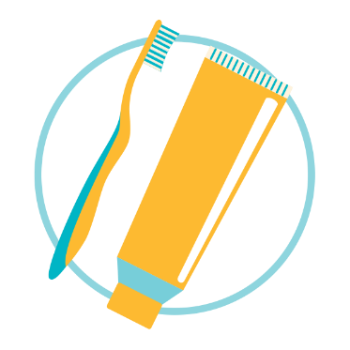
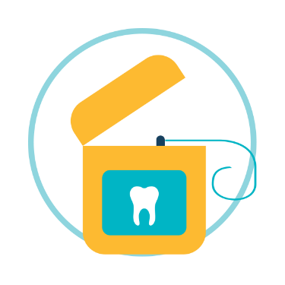
Watch your mouth
Balgownie Dental Surgery
Dental Health Week (6 to 12 August) is the Australian Dental Association’s major annual oral health promotion event. Its aim is to educate Australians about the importance of maintaining good oral health by promoting these key messages:
Brush twice daily, with fluoride toothpaste
Use floss at least once a day
Eat healthy and have less sugary drinks and food
Have regular check ups with your dentist
This important message will be driven with a little cheeky humour via the tagline “Watch your mouth”

Slide 3
Watch your mouth
Balgownie Dental Surgery
Tempting though it is to think everyone is watching their mouth and practicing good oral health, the reality is that:
65%
65% of Australians haven’t seen a dentist in the last two years
40%
Nearly 40% never floss or clean-in-between their teeth
50%
Just under 50% of Australians only brush once-a-day
73%
just over 73% of young people (14-18 years) are consuming too much sugar.

Slide 4
Step 1
Balgownie Dental Surgery
Brush twice a day, using fluoride toothpaste.
Brush your teeth for at least 2 minutes, twice a day.
Use a soft-bristled toothbrush with a small head and flexible neck.
Clean your teeth systematically, holding the toothbrush
at the gumline at a 45 degree angle.
Don’t press too hard – too much pressure can damage gums & tooth enamel.
Choose a toothpaste with fluoride and replace your toothbrush every 3 months.

Slide 5
Step 2
Balgownie Dental Surgery
Use floss at least once a day
Make flossing part of your oral hygiene regimen.
Floss at least once a day.
Ask your dentist to demonstrate the correct flossing technique.
Ask your dentist if interdental aids will complement your flossing.
Your children should floss too, start as soon as your child has two teeth that touch

Slide 6
Step 3
Balgownie Dental Surgery
Eat healthy and have less sugary drinks and food
Limit your sugar intake as it is the single-biggest cause of tooth decay.
Fluoridated tap water is best.
Read the ingredients panel on food products as many have hidden sugars.
Choose teeth friendly foods such as cheese, nuts and vegetables.
Avoid snacking and grazing.

Slide 7
Step 4
Balgownie Dental Surgery
Have regular dental check-ups
Make sure you visit your dentist regularly, at least once a year!
Regular dental check-ups are essential to maintaining good oral health
Dentists can check for problems that you might not see or feel, like early signs of tooth decay and gum disease.
The Australian Dental Association (ADA) website (www.ada.org.au) has a ‘Find a Dentist’ search tool.

Slide 8
Balgownie Dental Surgery

